Slide 1


Data Encoding
CSCI 2050U - Computer Architecture
Randy J. Fortier
@randy_fortier

Slide 2
Outline
Binary and hexadecimal
Information theory
Information
Entropy
Encoding
Fixed length
Variable length, prefix codes, Huffman’s algorithm
Errors detection and correction

Slide 3
Binary and Hexadecimal
CSCI 2050U - Computer Architecture

Slide 4
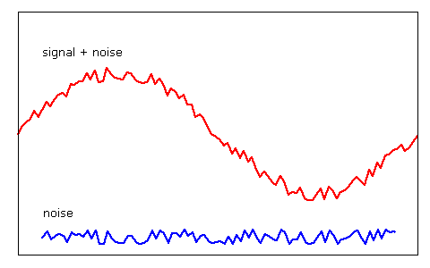
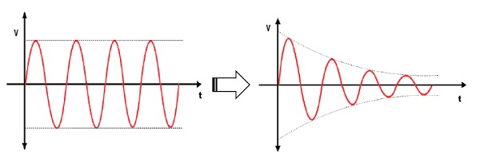
Binary
A signal needs to differentiate one value from another
Electronic: Voltage or no voltage, current or no current
Electromagnetic: Varying frequency, varying amplitude, varying phase
It might be possible to differentiate more than 2 values
e.g. Base 4: 0v, 1.5v, 3v, 4.5v
Attenuation and noise can make these differences harder to discern
Binary maximizes the likelihood of detecting the correct value

Slide 5
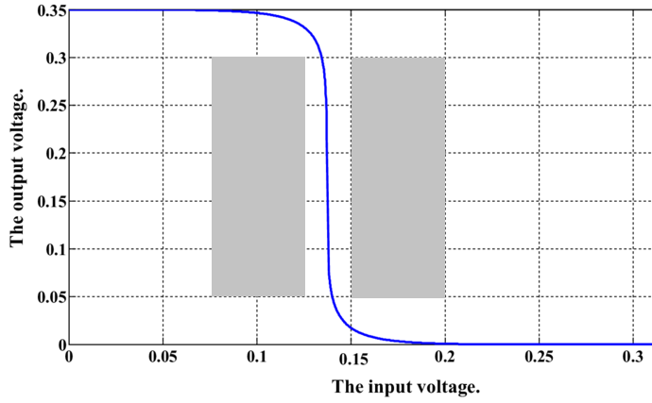
Voltage Characteristics
Let’s say we decide that 0.0v is a 0 and 0.35v is a 1
What if we receive 2.5v?
It would be better to design circuits that are not so black and white:
0: 0.00-0.05v
1: 0.30-0.35v
Undefined, otherwise

Slide 6
Converting from Binary to Decimal
Converting from binary to decimal is rather easy:

Slide 7
Converting from Binary to Decimal
1. Add each binary digit to the boxes below:
0
1
1
0
1
1
0
1

Slide 8
Converting from Binary to Decimal
2. Multiply each times the corresponding power of 2:
0
1
1
0
1
1
0
1
x128
x64
x32
x16
x8
x4
x2
x1
0
64
32
0
8
4
0
1

Slide 9
Converting from Binary to Decimal
3. Add up the results:
0
1
1
0
1
1
0
1
x128
x64
x32
x16
x8
x4
x2
x1
0
+
64
+
32
+
0
+
8
+
4
+
0
+
1
= 109

Slide 10
Converting from Decimal to Binary
Converting from decimal to binary is also easy:

Slide 11
Converting from Decimal to Binary
1. Write the number into the left-most box
109

Slide 12
Converting from Decimal to Binary
2. Divide by the corresponding power of two
109
÷128
÷64
÷32
÷16
÷8
÷4
÷2
÷1

Slide 13
Converting from Decimal to Binary
3. Write the (integer) quotient in the box, below
109
÷128
÷64
÷32
÷16
÷8
÷4
÷2
÷1
0

Slide 14
Converting from Decimal to Binary
3. Write the remainder in the box to the right
109
109
÷128
÷64
÷32
÷16
÷8
÷4
÷2
÷1
0

Slide 15
Converting from Decimal to Binary
4. Repeat for the remaining numbers
109
109
45
÷128
÷64
÷32
÷16
÷8
÷4
÷2
÷1
0
1

Slide 16
Converting from Decimal to Binary
4. Repeat for the remaining numbers
109
109
45
13
÷128
÷64
÷32
÷16
÷8
÷4
÷2
÷1
0
1
1

Slide 17
Converting from Decimal to Binary
4. Repeat for the remaining numbers
109
109
45
13
13
÷128
÷64
÷32
÷16
÷8
÷4
÷2
÷1
0
1
1
0

Slide 18
Converting from Decimal to Binary
4. Repeat for the remaining numbers
109
109
45
13
13
5
÷128
÷64
÷32
÷16
÷8
÷4
÷2
÷1
0
1
1
0
1

Slide 19
Converting from Decimal to Binary
4. Repeat for the remaining numbers
109
109
45
13
13
5
1
÷128
÷64
÷32
÷16
÷8
÷4
÷2
÷1
0
1
1
0
1
1

Slide 20
Converting from Decimal to Binary
4. Repeat for the remaining numbers
109
109
45
13
13
5
1
1
÷128
÷64
÷32
÷16
÷8
÷4
÷2
÷1
0
1
1
0
1
1
0

Slide 21
Converting from Decimal to Binary
4. Repeat for the remaining numbers
109
109
45
13
13
5
1
1
÷128
÷64
÷32
÷16
÷8
÷4
÷2
÷1
0
1
1
0
1
1
0
1

Slide 22
Hexadecimal
Modern computers only use binary
Memory addresses
Encrypted or compressed data
Integers (signed or unsigned)
Floating points
Text
Sometimes, us humans need to look at binary data
Too long, easy to make mistakes

Slide 23
Hexadecimal
Binary | Hex |  | Binary | Hex
0000 | 0x0 |  | 1000 | 0x8
0001 | 0x1 |  | 1001 | 0x9
0010 | 0x2 |  | 1010 | 0xA
0011 | 0x3 |  | 1011 | 0xB
0100 | 0x4 |  | 1100 | 0xC
0101 | 0x5 |  | 1101 | 0xD
0110 | 0x6 |  | 1110 | 0xE
0111 | 0x7 |  | 1111 | 0xF
Hexadecimal is a base-16 number system
Advantage:
As 16 is a power of 2, binary ↔ hexadecimal
We can use a table for conversion:
There are no unmapped numbers
2 hex digits per byte
Disadvantage:
We don’t have 16 digit symbols
Hexadecimal uses 0-9, and A-F

Slide 24
Information Theory Basics
CSCI 2050U - Computer Architecture

Slide 25
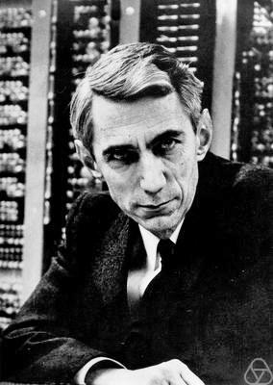
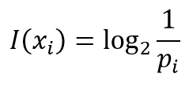
Information
Information, according to Claude Shannon (1948), is how much uncertainty is resolved by a message
Imagine I wanted to tell you what video game I received as a birthday present
How much information would be in that message?
If there were 64 potential video games to choose from, the prior probability of receiving the one game that was received was 1/64
Therefore, if I tell you which game I received, then I’ve given you just enough information to resolve the 1/64 uncertainty that existed before I told you
Notes:
Pi - the probability of event i
Xi - a message resolving the uncertainty that event i has occurred
I(xi) - the information (in bits) that message xi carries

Slide 26






Information: An Example
You are a witness to a major crime
Which of the following carries more information?
The murderer was male
The murderer had grey hair
The murderer’s name is Tom

Slide 27
Information: An Example
You are a witness to a major crime
Which of the following carries more information?
The murderer was male I(x_{male}) = log₂(5/2) ≈ 1.32
The murderer had grey hair I(x_{grey}) = log₂(5/1) ≈ 2.32
The murderer’s name is Tom I(x_{tom}) = log₂(5/2) ≈ 1.32

Slide 28
Information
What does 1.32 bits of information mean?
We cannot send 1.32 bits
If we are sending one message, we must use at least 2 bits of information
If we are sending many such messages, however, we could compact the information further
This opens the door to compression

Slide 29
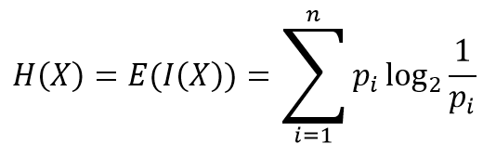
Entropy
Entropy is a measure of the average information in a message
The entropy is simply a weighted sum of the information of each received message:
Entropy is the minimum information that we need (lower bound)
Any less and we cannot resolve all of the uncertainty
Any more and we are being inefficient

Slide 30
Encoding
CSCI 2050U - Computer Architecture

Slide 31
Fixed-length Encoding
Say we want to encode DNA in binary
DNA is made up of sequences of nucleotides
There are four possible values (see table)
For simplicity, we’ll say that each is equally likely
A | adenine
C | cytosine
G | guanine
T | thymine

Slide 32
Fixed-length Encoding
Say we want to encode DNA in binary
DNA is made up of sequences of nucleotides
There are four possible values (see table)
For simplicity, we’ll say that each is equally likely
Other fixed-length encodings:
ASCII
A | adenine | 00
C | cytosine | 01
G | guanine | 10
T | thymine | 11

Slide 33
Variable-length Encoding
What if the choices are not equally likely?
Consider letters in the English alphabet (e.g. encoding a text message)
We could save some space if more common letters were given shorter codes
Let’s say that ‘a’ and ‘b’ are common, but ‘c’ and ‘d’ are less common
What about the following codes?
Letter | Code
a | 0
b | 1
c | 00
d | 11

Slide 34
Variable-length Encoding
Let’s consider the binary value: 000111
Possible interpretations:
aaabbb
acbd
cabd
acdb
cadb
aaabd
aaadb
acbbb
cabbb
Letter | Code
a | 0
b | 1
c | 00
d | 11

Slide 35
Variable-length Encoding
In order to avoid ambiguity, we need the codes to be prefix codes
In a prefix code, each code has a unique prefix that is not shared with any other code
In this way, we can identify each encoded symbol
Let’s consider the binary value: 110100101
The only interpretation of this binary value is badc
Letter | Code
a | 0
b | 11
c | 101
d | 100

Slide 36
Huffman’s Algorithm
1. HUFFMAN(C):
2. n = |C|
3. Q = C
4. for i = 1 to n-1
5. create a new node z
6. x = EXTRACT-MIN(Q)
7. y = EXTRACT-MIN(Q)
8. z.left = x
9. z.right = y
10. z.freq = x.freq + y.freq
11. INSERT(Q,z)
12. end for
13. return EXTRACT-MIN(Q)

Slide 37
Huffman’s Algorithm
Huffman’s algorithm uses a (min) priority queue
A priority queue behaves like a queue, except that higher priority items jump ahead of lower priority items
This is similar to triage in an emergency room
Character | Frequency
a | 45
b | 13
c | 12
d | 16
e | 9
f | 5
Notes:
A min priority queue is a priority queue that considers smaller values to be better priority

Slide 38
Huffman’s Algorithm
We start by adding all characters/frequencies to a min priority queue
Frequencies, in this case, are the priority value
Character | Frequency
a | 45
b | 13
c | 12
d | 16
e | 9
f | 5
f: 5
e: 9
c: 12
b: 13
d: 16
a: 45

Slide 39
Huffman’s Algorithm
Dequeue the first two elements from the priority queue
Join them together into a single node and enqueue that new node
The frequency of the new node is the sum of the frequencies of the two elements dequeued
Character | Frequency
a | 45
b | 13
c | 12
d | 16
e | 9
f | 5
c: 12
b: 13
ef: 14
d: 16
a: 45
f: 5
e: 9

Slide 40
Huffman’s Algorithm
Keep repeating this process until there is only a single node in the queue:
Character | Frequency
a | 45
b | 13
c | 12
d | 16
e | 9
f | 5
ef: 14
d: 16
bc: 25
a: 45
f: 5
e: 9
c: 12
b: 13

Slide 41
Huffman’s Algorithm
Keep repeating this process until there is only a single node in the queue:
Character | Frequency
a | 45
b | 13
c | 12
d | 16
e | 9
f | 5
bc: 25
def: 30
a: 45
c: 12
b: 13
ef: 14
d: 16
f: 5
e: 9

Slide 42
Huffman’s Algorithm
Keep repeating this process until there is only a single node in the queue:
Character | Frequency
a | 45
b | 13
c | 12
d | 16
e | 9
f | 5
a: 45
bcdef: 55
bc: 25
def: 30
c: 12
b: 13
ef: 14
d: 16
f: 5
e: 9

Slide 43
Huffman’s Algorithm
Keep repeating this process until there is only a single node in the queue:
abcdef: 100
Character | Frequency
a | 45
b | 13
c | 12
d | 16
e | 9
f | 5
a: 45
bcdef: 55
bc: 25
def: 30
c: 12
b: 13
ef: 14
d: 16
f: 5
e: 9

Slide 44
Huffman’s Algorithm
Now label each left child 0, and each right child 1
The prefix codes for each letter can be found by tracing the path to that node in this tree
abcdef: 100
Character | Frequency | Prefix Code
a | 45 | 0
b | 13 | 101
c | 12 | 100
d | 16 | 111
e | 9 | 1101
f | 5 | 1100
0
1
a: 45
bcdef: 55
0
1
bc: 25
def: 30
0
1
0
1
c: 12
b: 13
ef: 14
d: 16
0
1
f: 5
e: 9
Notes:
Any idea what algorithm strategy is used by Huffman's algorithm?

Slide 45
Detecting and Correcting Errors
CSCI 2050U - Computer Architecture

Slide 46
Error Detection
The simplest way to detect an error is to use a parity bit
A redundant bit to ensure that no bits were changed (0 ➝ 1, 1 ➝ 0)
Even parity - set the parity bit such that the total number of 1s is even
Odd parity - set the parity bit such that the total number of 1s is odd
Can only detect single-bit errors
Cannot correct the error

Slide 47
Error Detection
Example (even parity):
Sent: 0000 0110 0
Received: 0000 0100 0
The total number of 1s is 1, which is odd
Therefore, there must have been an error

Slide 48
Error Detection
Another example (even parity):
Sent: 0000 0110 0
Received: 0010 0100 0
The total number of 1s is 2, which is even
No error is detected

Slide 49
Hamming Distance
Hamming distance is the number of symbols in one string that are different from the symbols at the same location in another string
Example:
0011 0110 0111 1011
0010 0011 0110 1011
Hamming distance: 4

Slide 50
Hamming Distance
A parity bit can only detect errors where the hamming distance is 1
One way to improve our resistance to errors is to choose an encoding where the hamming distance between values is larger
Example:
000 represents 0
111 represents 1
Now, if we receive 010, we could assume that this was a 0 value

Slide 51
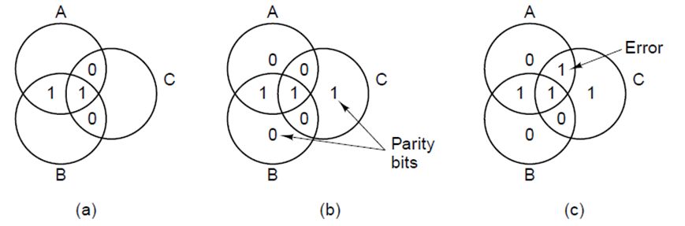
Error Correction
The following is a simple scheme for encoding data such that errors are correctable
The scheme used by ECC RAM is similar
In the left diagram, we have 4 bits of information encoded
In the centre diagram, the ‘parity’ bits have been added to make even parity within the circles
The parity overlaps, so that we can figure out which bit is in error
The right diagram shows an example with a data bit error (parity bit errors are similar)

Slide 52
Error Correction
Let’s do an example (even parity)
Consider the following bits: 1100
A
0
1
0
C
1
B

Slide 53
Error Correction
Let’s do an example (even parity)
What should the parity bit be for A?
A
0
1
0
C
1
B

Slide 54
Error Correction
Let’s do an example (even parity)
What should the parity bit be for A? 1
A
1
0
1
0
C
1
B

Slide 55
Error Correction
Let’s do an example (even parity)
What should the parity bit be for B?
A
1
0
1
0
C
1
B

Slide 56
Error Correction
Let’s do an example (even parity)
What should the parity bit be for B? 0
A
1
0
1
0
C
1
0
B

Slide 57
Error Correction
Let’s do an example (even parity)
What should the parity bit be for C?
A
1
0
1
0
C
1
0
B

Slide 58
Error Correction
Let’s do an example (even parity)
What should the parity bit be for C? 1
A
1
0
1
0
1
C
1
0
B

Slide 59
Error Correction
Let’s do another example (even parity)
Let’s verify the parity bits:
A:
A
0
0
1
1
0
C
0
1
B

Slide 60
Error Correction
Let’s do another example (even parity)
Let’s verify the parity bits:
A: correct
B:
A
0
0
1
1
0
C
0
1
B

Slide 61
Error Correction
Let’s do another example (even parity)
Let’s verify the parity bits:
A: correct
B: incorrect
C:
A
0
0
1
1
0
C
0
1
B

Slide 62
Error Correction
Let’s do another example (even parity)
Let’s verify the parity bits:
A: correct
B: incorrect
C: incorrect
Since the error must be in both B and C, but not A, the error must be here
A
0
0
1
1
0
C
0
1
B

Slide 63
Error Correction
Let’s do another example (even parity)
Let’s verify the parity bits:
A:
A
1
0
1
0
1
C
0
1
B

Slide 64
Error Correction
Let’s do another example (even parity)
Let’s verify the parity bits:
A: correct
B:
A
1
0
1
0
1
C
0
1
B

Slide 65
Error Correction
Let’s do another example (even parity)
Let’s verify the parity bits:
A: correct
B: correct
C:
A
1
0
1
0
1
C
0
1
B

Slide 66
Error Correction
Let’s do another example (even parity)
Let’s verify the parity bits:
A: correct
B: correct
C: incorrect
Since the error must be in C, but not in A or B, the error must be the parity bit in C
The parity bits even check themselves!
A
1
0
1
0
1
C
0
1
B

Slide 67
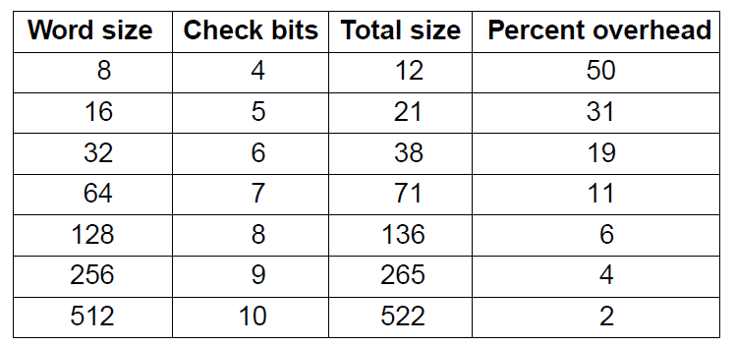
Error Correction
Extending this system to larger values is a bit more complicated
The overhead (extra bits required) becomes less significant for larger values

Slide 68
Wrap-up
Other bases: binary and hexadecimal
Information theory
What is information?
What is entropy?
Encoding
Fixed length
Variable length, prefix codes, Huffman’s algorithm
Errors detection and correction

